Slide 1
Content
1. Visits
2. Summary of drugs/operations/lasers
3. Costs
4. Verfication

Slide 2
1. Visits

Slide 3
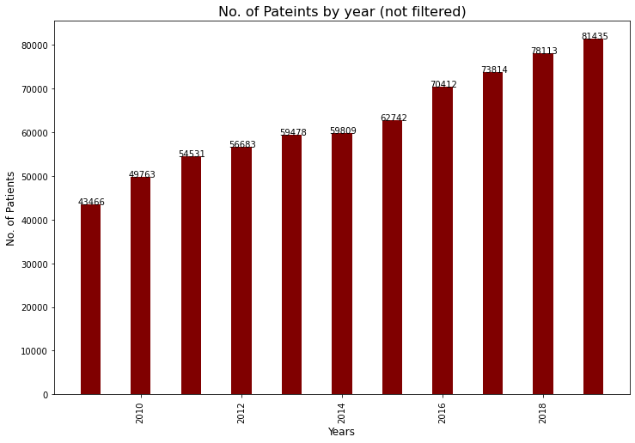
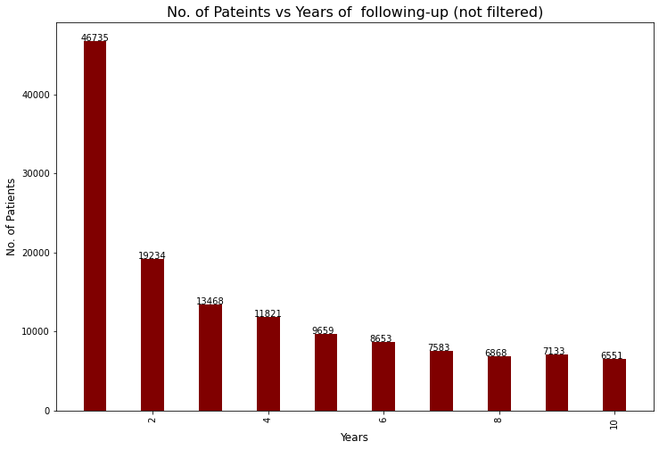
Visits(1/4) - All Combined files (drugs/operations/lasers/diagonse)
154016 in total

Slide 4
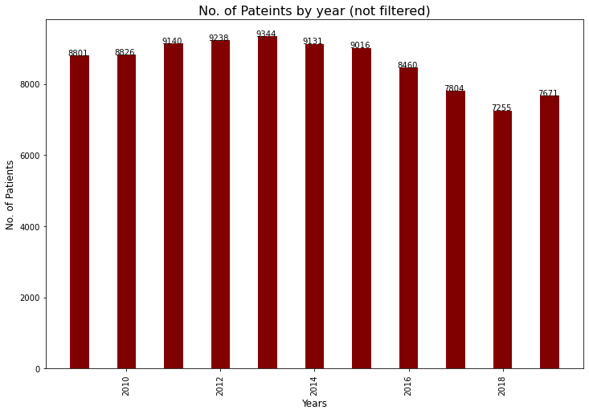
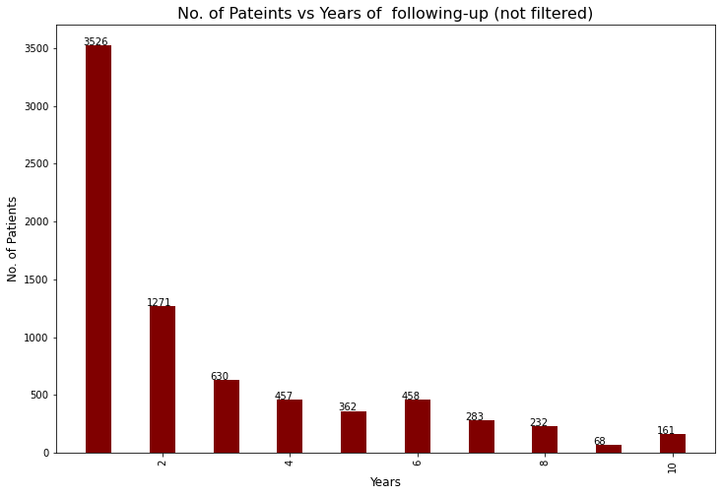
All Combined files (drugs/operations/lasers/diagonse) in HKWC only
14201 in total

Slide 5
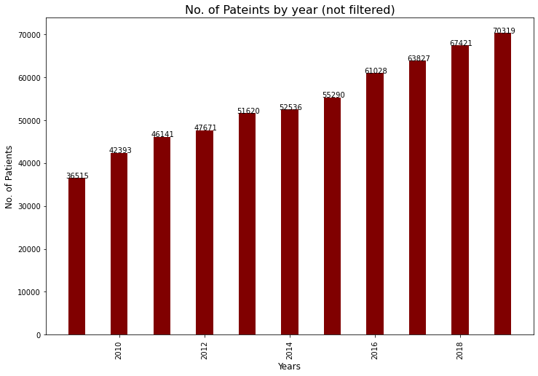
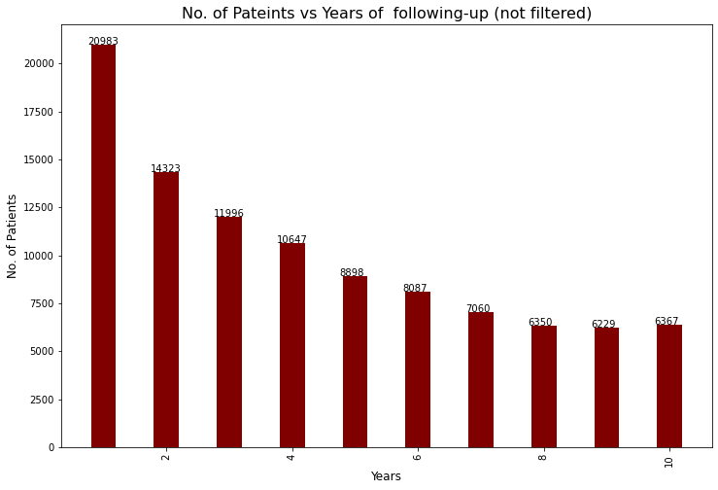
Visits(2/4) - All Combined files (drugs>=180/operations/lasers/diagonse)
114904 in total

Slide 6
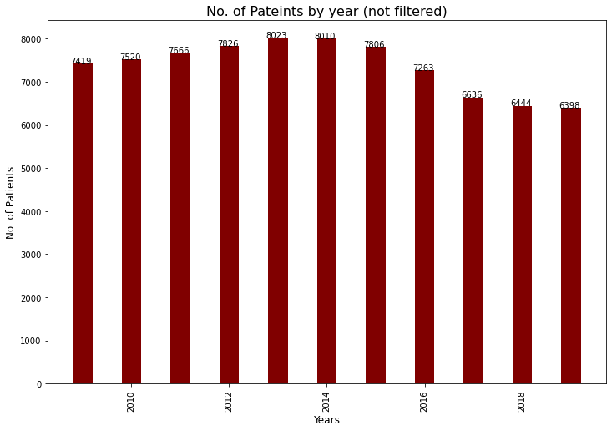
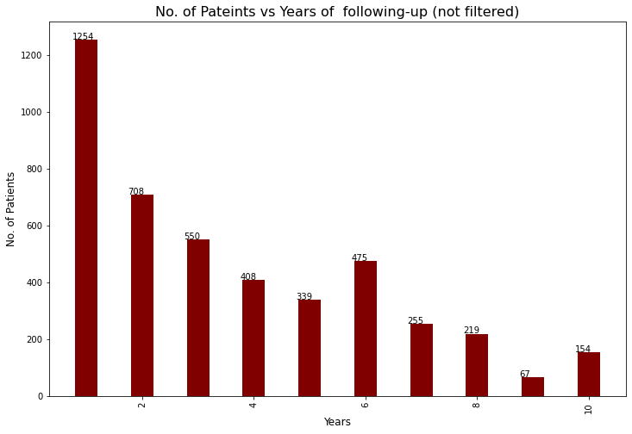
All Combined files (drugs>=180/operations/lasers/diagonse) in HKWC only
10323 in total

Slide 7
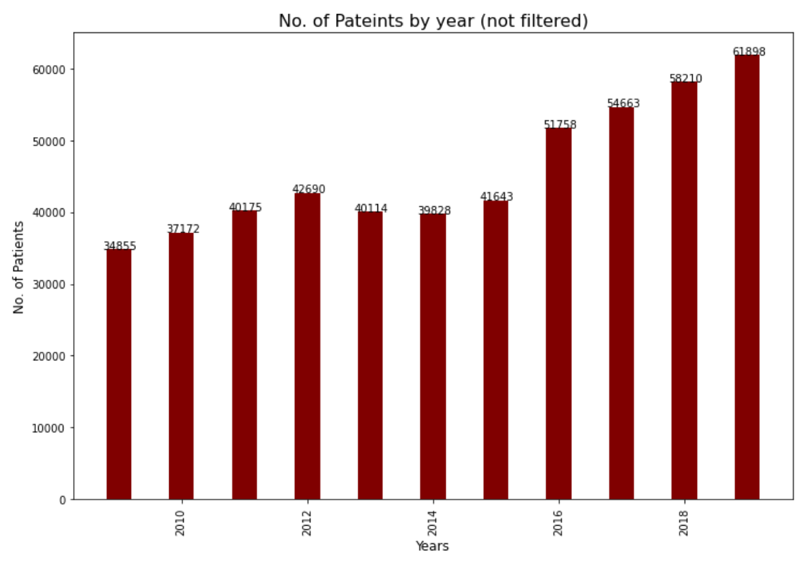
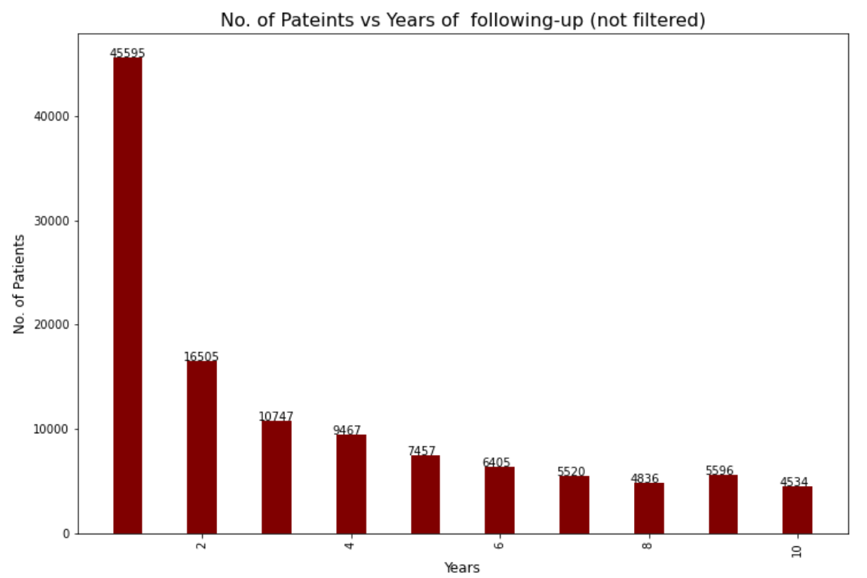
Visits(3/4) - Use drug excels only
126257 in total

Slide 8
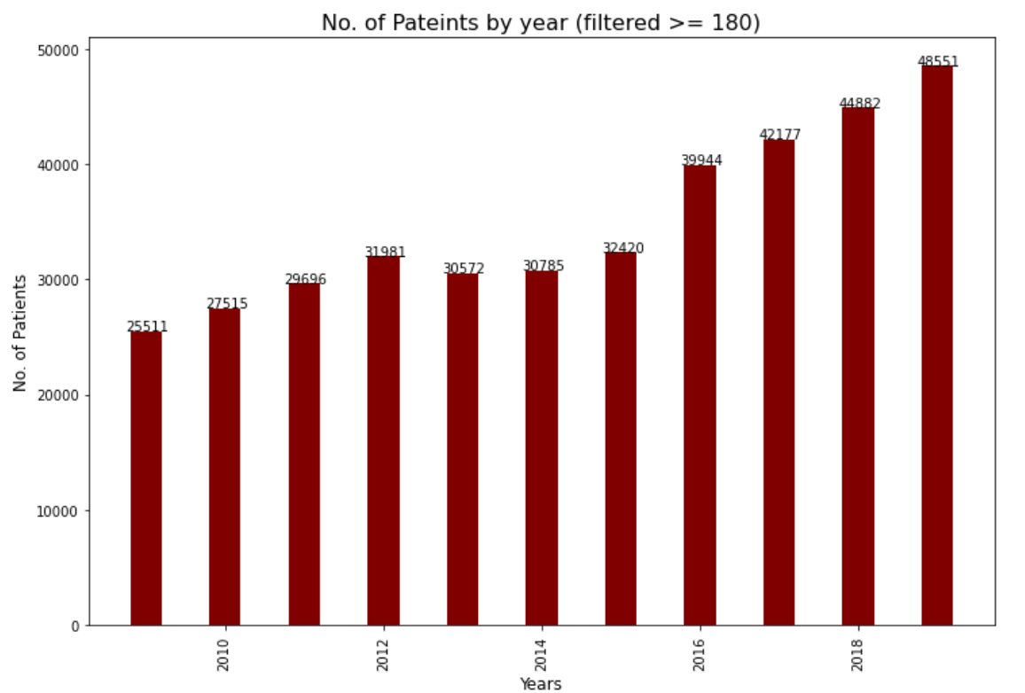
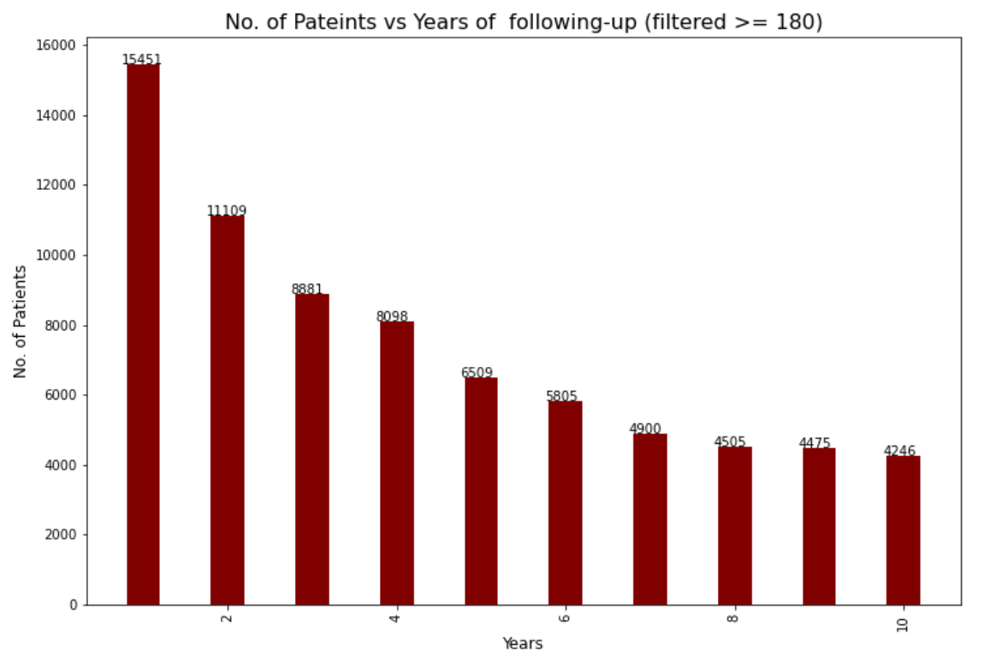
Visits(4/4) - Use drug excels only (>=180)
80059 in total

Slide 9
2. Summary of Drugs/Operations/Lasers

Slide 10
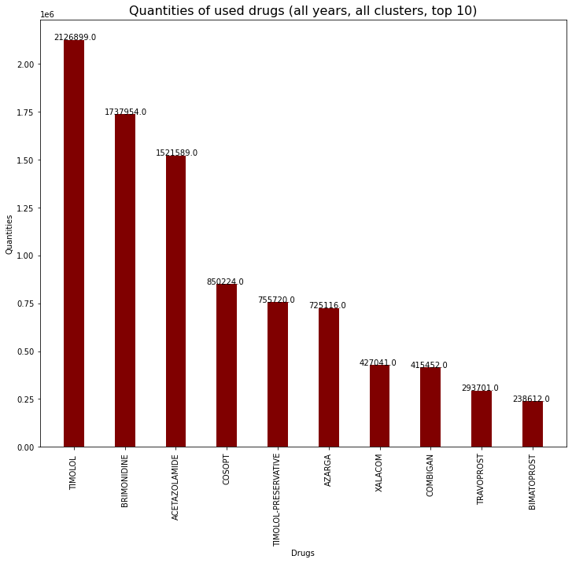
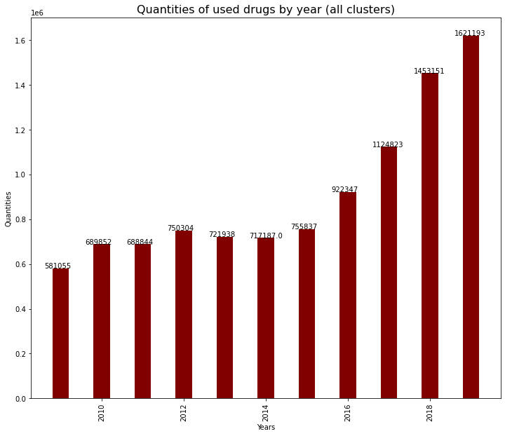
Drugs - 23 types, patients >=180 only

Slide 11
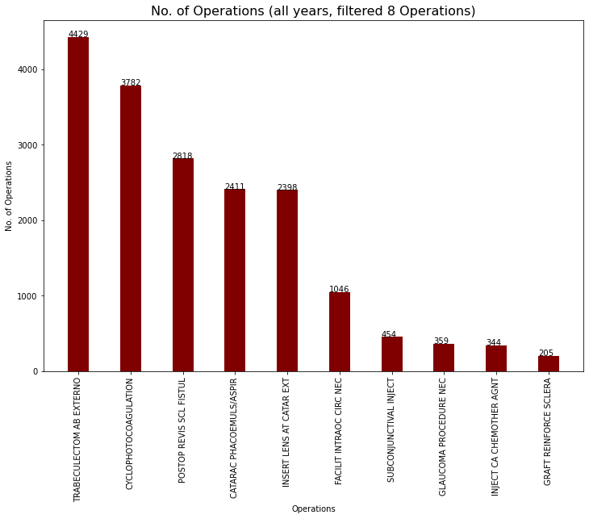
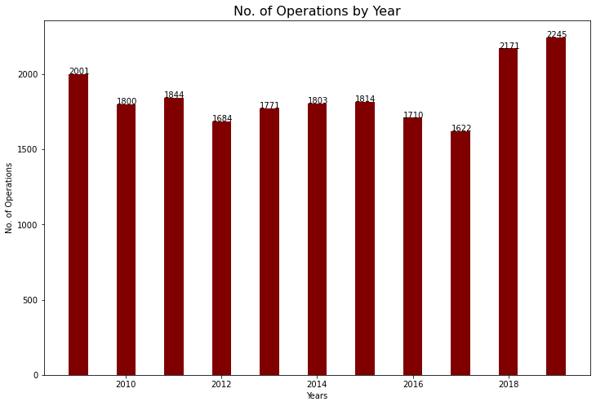
Operations(1/2) - all 96 types

Slide 12
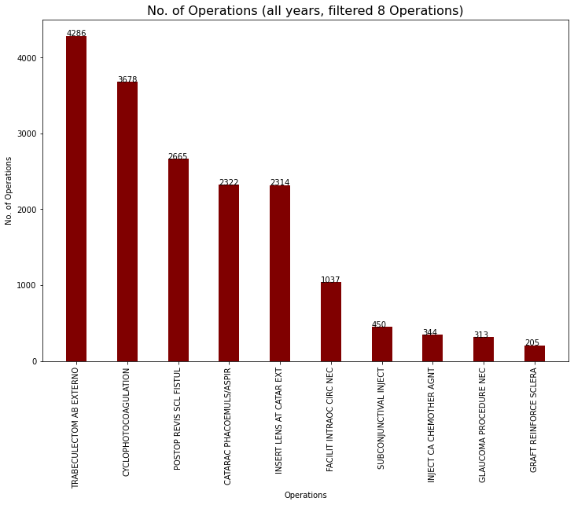
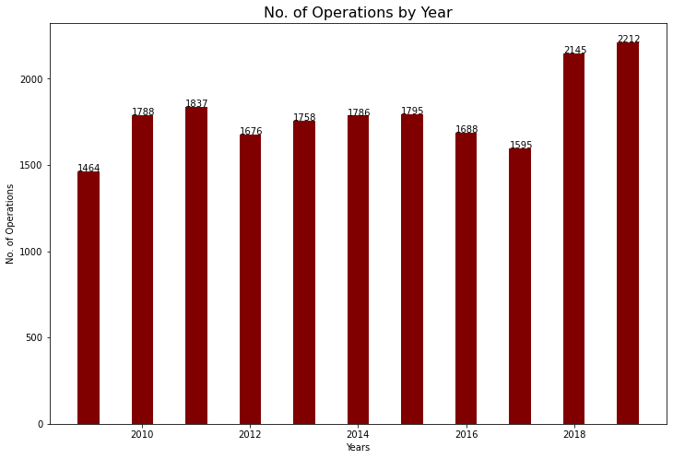
Operations(2/2) - selected 8 types

Slide 13
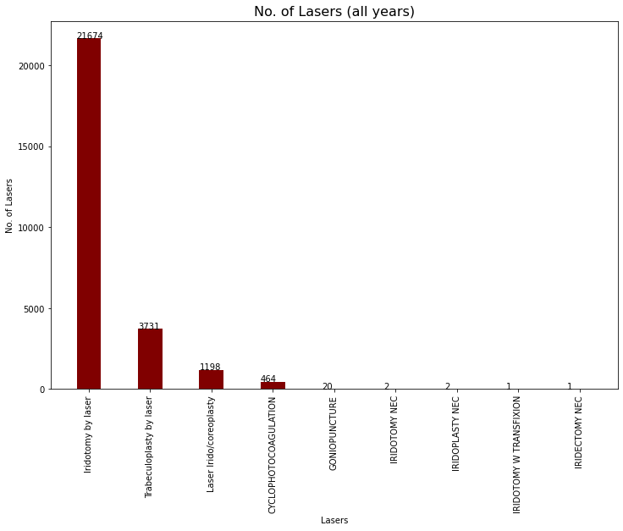
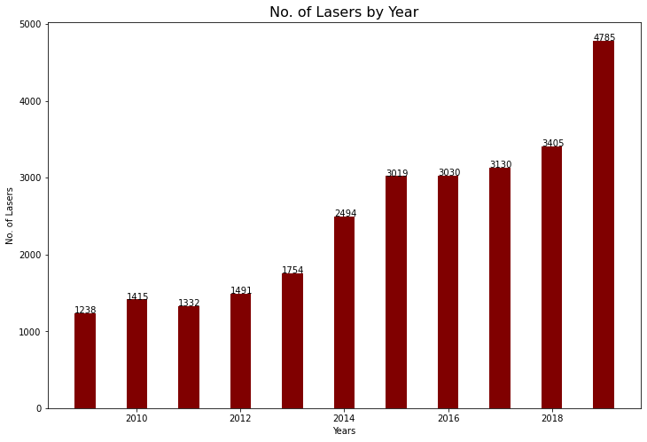
Lasers - selected 9 types

Slide 14
3. Costs

Slide 15
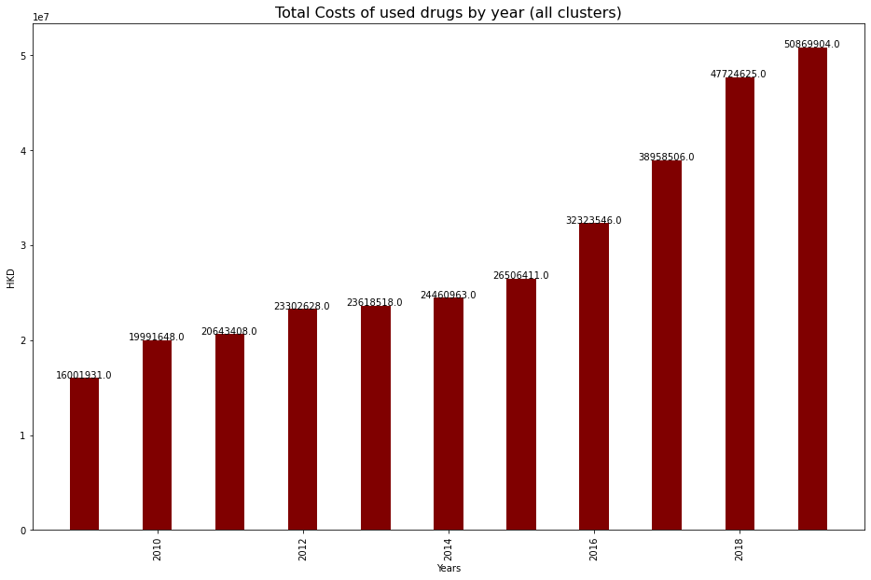
Total Costs - Drugs(pateints >=180)
Overall Cost of Drugs(2009-2019) = HKD 324,402,088

Slide 16
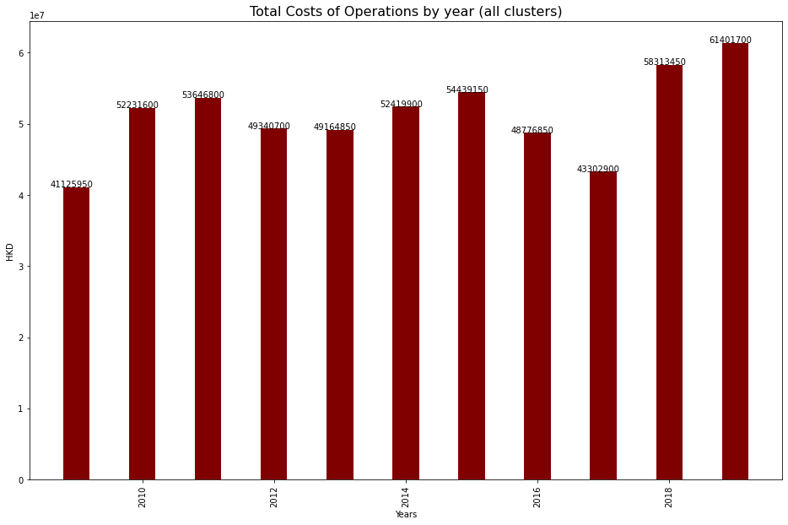
Total Costs - Operations
Overall Cost of Operations(2009-2019) =
HKD 564,163,850

Slide 17
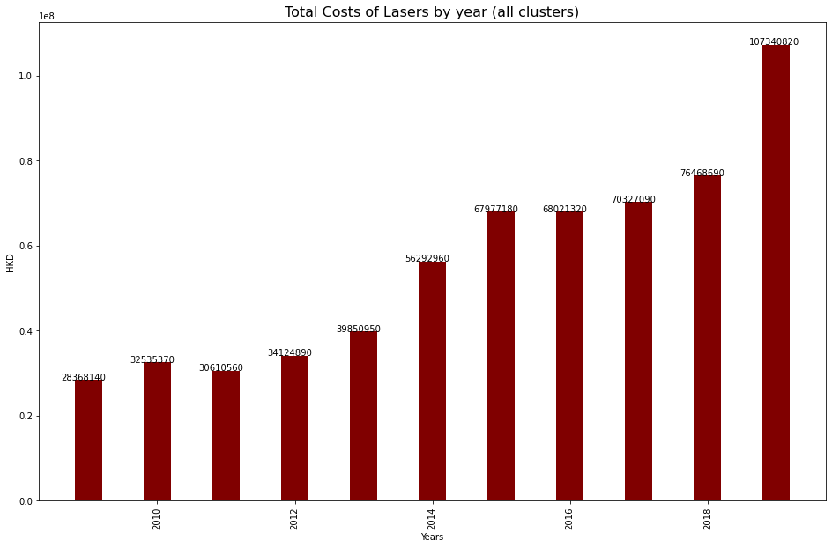
Total Costs - Lasers
Overall Cost of Lasers(2009-2019) =
HKD 61,197,970

Slide 18
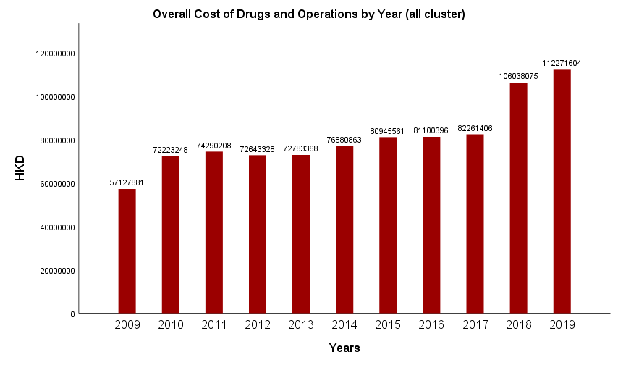
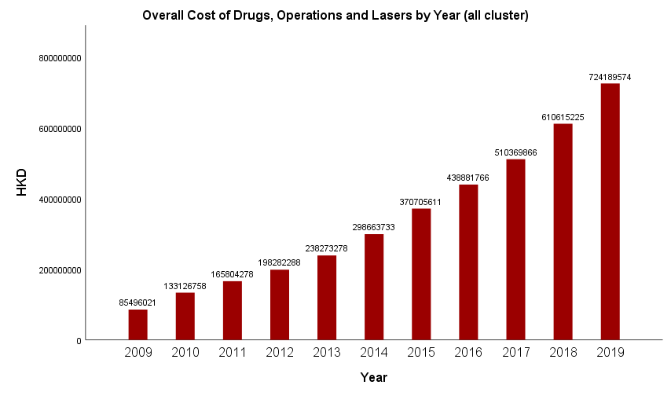
Total Costs - Overall
Overall Cost of Drugs+Operations =
HKD 888,565,938
Overall Cost of Drugs+Operations+Lasers =
HKD 3,774,408,398

Slide 19
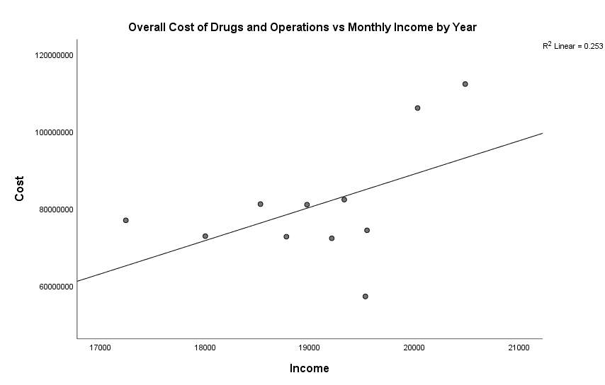
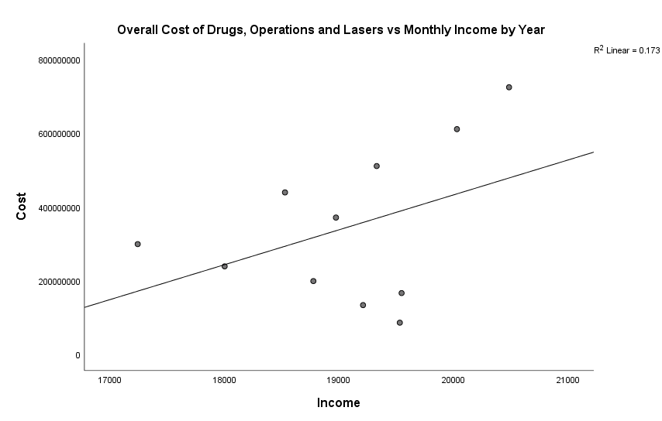
Association between costs and incomes:

Slide 20
4. Verfication

Slide 21
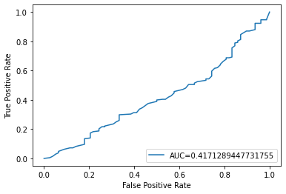
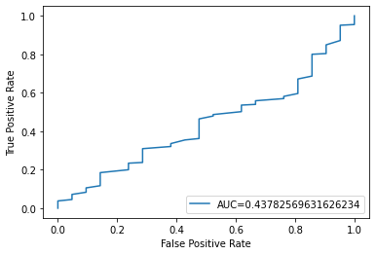
Data Verfication
All data were randomly selected from >=180
>=180 as threshold: 1）265(92.7%) Glaucoma/OHT/PAC out of 286;
2）208(72.7%) Glaucoma out of 286;
Glaucoma vs. Others
Glaucoma/PAC/OHT vs. No Glaucoma
Finding: AUC is closer to 0.5, which means there is no better criteria in [180: 366] for distinguishing galucoma and others.

